Slide 1
Chapter 4
Requirements Engineering

Slide 2
Learning Objectives (1 of 3)
After this chapter, you will be able to:
Explain system requirements and the challenges associated with the requirements engineering process
Compare and contrast functional and non-functional requirements
Apply team-based requirements engineering techniques, including joint application development (JAD), rapid application development (RAD), and agile methods

Slide 3
Learning Objectives (2 of 3)
Develop a fact-finding plan for gathering requirements
Conduct an interview to gather system requirements
Use other requirements gathering techniques, including document review, observation, questionnaires and surveys, brainstorming, sampling, and research
Explain how requirements are gathered in agile projects

Slide 4
Learning Objectives (3 of 3)
Utilize different requirements representation techniques, including natural language, diagrams, and models
Explain how to validate and verify requirements
Explain how tools can help with requirements engineering activities

Slide 5
System Requirements (1 of 3)
Feature that must be included in an information system to satisfy business requirements
Benchmarks to measure overall acceptability
Requirements engineering activities
Gathering requirements
Representing requirements
Validating and verifying requirements

Slide 6
System Requirements (2 of 3)
Types of requirements
Classified according to characteristics
Functional and non-functional
Requirements challenges
Imprecision
Agreement
Creep

Slide 7
System Requirements (3 of 3)
Additional considerations
Scalability: ability to handle increased business volume and transactions
Security: make systems harder to infiltrate
Total cost of ownership: direct and indirect costs

Slide 8
Team-Based Techniques (1 of 8)
Joint application development
Brings users into the development process as active participants
User Involvement
Active roles
Formal or informal
JAD participants and roles
Project leader and one or more members

Slide 9
Team-Based Techniques (2 of 8)
JAD advantages and disadvantages
Disadvantages
More expensive than traditional methods
Can be cumbersome if the group is too large
Advantages
Allows key users to participate effectively
Users are more likely to feel a sense of ownership
Produces a more accurate statement of system requirements, a better understanding of common goals, and a stronger commitment to the success of the new system

Slide 10
Team-Based Techniques (3 of 8)
Rapid application development
Uses a group approach like JAD
End product: new information system
Complete methodology
Includes a four-phase life cycle that parallels the traditional SDLC
Reduces cost and development time
Increases the probability of success
Relies on prototyping and user involvement

Slide 11
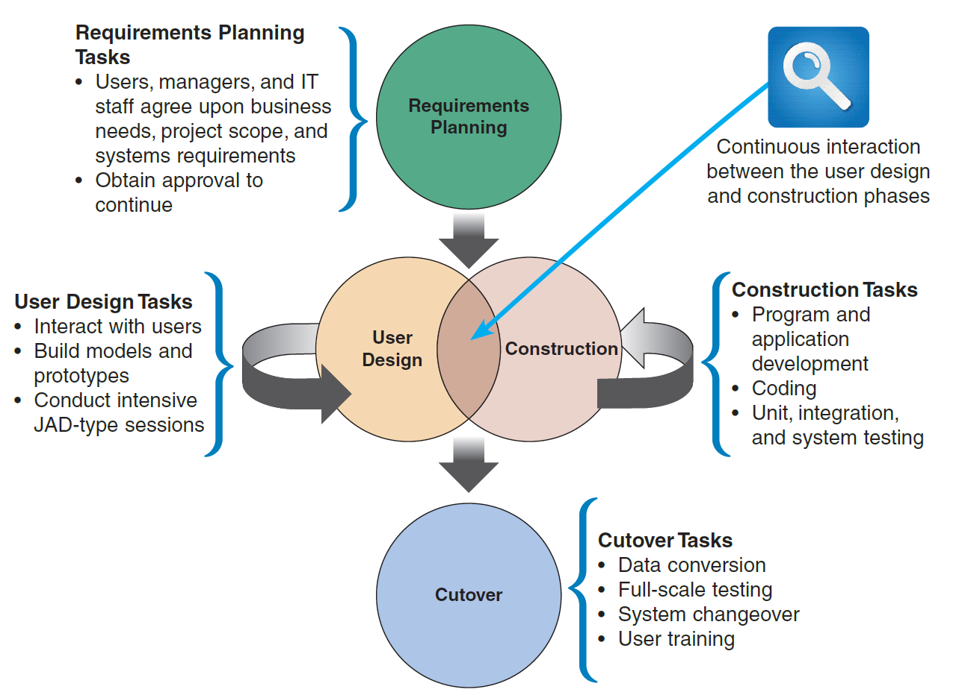
Team-Based Techniques (4 of 8)
FIGURE 4-4 The four phases of the RAD model are requirements planning, user design, construction, and cutover. Notice the continuous interaction between the user design and construction phases.

Slide 12
Team-Based Techniques (5 of 8)
RAD objectives
Cut development time and expense
Involve users in every phase of development
RAD advantages and disadvantages
Advantage
Helps develop systems quickly with cost savings
Disadvantages
Does not emphasize strategic business needs
Less time to develop quality, consistency, and design standards

Slide 13
Team-Based Techniques (6 of 8)
Agile methods
Attempt to develop a system incrementally by building a series of prototypes and adjusting them to user requirements
Developers revise, extend, and merge earlier versions into the final product
Emphasize continuous feedback
Each incremental step is affected by what was learned in the prior steps

Slide 14
Team-Based Techniques (7 of 8)
Scrum
Scrum sessions
Specific guidelines emphasize time blocks, interaction, and team-based activities that result in deliverable software

Slide 15
Team-Based Techniques (8 of 8)
Agile method advantages and disadvantages
Advantages
Very flexible and efficient in dealing with change
Frequent deliverables constantly validate the project and reduce risk
Disadvantages
Team members need a high level of technical and interpersonal skills
Lack of structure and documentation can introduce risk factors
May be subject to significant change in scope

Slide 16
Gathering Requirements
First step in requirements engineering process
Requirements elicitation or fact-finding
Who?
What?
Where?
When?
How?

Slide 17
Gathering Requirements Through Interviews (1 of 6)
The interview process
Determine the people to interview
Establish objectives for the interview
Develop interview questions
Prepare for the interview
Conduct the interview
Document the interview
Evaluate the interview

Slide 18
Gathering Requirements Through Interviews (2 of 6)
Determine the people to interview
Select the right people and ask the right questions
Consider candidates from both formal and informal structures
Decide on group and/or individual interviews
Establish objectives for the interview
Determine areas to be discussed
List facts that need to be gathered
Objectives depend on the role of the person being interviewed

Slide 19
Gathering Requirements Through Interviews (3 of 6)
Develop interview questions
Decide what to ask and how to phrase it
Avoid leading questions
Open-ended questions encourage spontaneous and unstructured responses
Close-ended questions limit the response
Range-of-response questions limit the response

Slide 20
Gathering Requirements Through Interviews (4 of 6)
Prepare for the interview
Careful preparation is essential
Limit the interview to no more than one hour
Verify time, place, length, and topics
If there are questions about documents, ask the interviewee to have samples available at the meeting

Slide 21
Gathering Requirements Through Interviews (5 of 6)
Conduct the interview
Develop a specific plan for the meeting
Begin by introducing yourself, describing the project, and explaining your interview objectives
Practice engaged listening
Allow the person enough time to think about the question and arrive at an answer
After an interview, summarize the session and seek a confirmation

Slide 22
Gathering Requirements Through Interviews (6 of 6)
Document the interview
Note taking should be kept to a minimum
After conducting the interview record the information quickly
Send memo to the interviewee expressing your appreciation
Evaluate the interview
In addition to recording the facts obtained in an interview, try to identify any possible biases

Slide 23
Gathering Requirements Using Other Techniques (1 of 5)
Document review
Review current documentation
Observation
Provides additional perspective and a better understanding of the system procedures
Should be planned in advance

Slide 24
Gathering Requirements Using Other Techniques (2 of 5)
Questionnaires and surveys
Make sure questions collect the right data in a form that can be used to further the fact finding effort
Can be traditional forms, fill-in forms, or on the Internet or a company intranet

Slide 25
Gathering Requirements Using Other Techniques (3 of 5)
Interviews versus questionnaires
Interview is more familiar and personal
Costly and time-consuming process
Questionnaire gives the opportunity to provide input and suggestions
Recipients can answer questions at their convenience
Brainstorming: small group discussion of a specific problem, opportunity, or issue
Structured brainstorming
Unstructured brainstorming

Slide 26
Gathering Requirements Using Other Techniques (4 of 5)
Sampling
Systematic sample: selection of every tenth customer for review
Stratified sample: selection of five customers from each of four postal codes
Random sample: selection of any 20 customers
Objective of a sample: ensure it represents the overall population accurately

Slide 27
Gathering Requirements Using Other Techniques (5 of 5)
Research
Internet, IT magazines, and books
Used to obtain background information, technical material, and news about industry trends and developments
Attending professional meetings, seminars, and discussions with other IT professionals
Site visits

Slide 28
Gathering Requirements In Agile Projects
Agile methods used for requirements gathering
Variation on interviews that focuses on features, user stories, scenarios, and storyboards is used
Requirements are gathered and successively refined

Slide 29
Representing Requirements (1 of 5)
Principles for documentation
Record information as soon as it is obtained
Use the simplest recording method
Record findings in a way that they can be understood by someone else
Organize documentation so related material is located easily

Slide 30
Representing Requirements (2 of 5)
Natural language
Vast majority of requirements are represented using unstructured natural language
Diagrams
Graphical methods and nontechnical language that represent the system at various stages
Functional decomposition diagrams
Top-down representation of a function or process

Slide 31
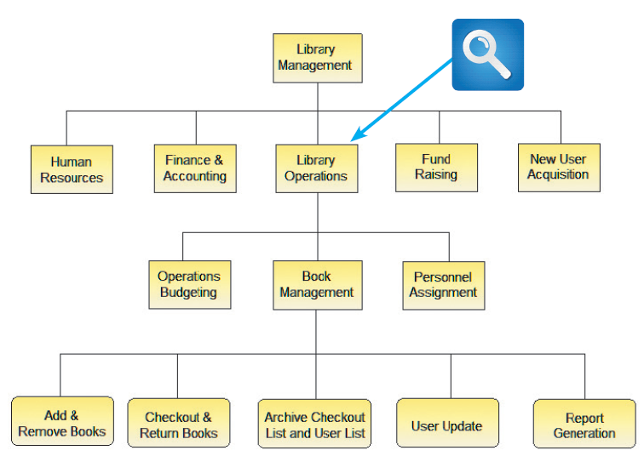
Representing Requirements (3 of 5)
FIGURE 4-15 This Visible Analyst FDD shows a library system with five top-level functions. The Library Operations function includes two additional levels of processes and sub-processes. Source: Screenshot used with permission from Visible Systems Corporation.

Slide 32
Representing Requirements (4 of 5)
Business process diagrams
Represent one or more business processes
Business process modeling notation (BPMN) includes various shapes and symbols to represent events, processes, and workflows
Data flow diagrams
Show how the system stores, processes, and transforms data

Slide 33
Representing Requirements (5 of 5)
Models
Provide a more formal representation of system requirements
Unified Modeling Language (UML)
Use case diagram
Visually represents the interaction between users and the information system
Sequence diagram
Shows timing of interactions between objects

Slide 34
Validating And Verifying Requirements
Requirements validation and verification (V&V)
Concerned with demonstrating that the requirements define the system that the customer really wants
Validation: Are the correct requirements stated?
Verification: Are the requirements stated correctly?

Slide 35
Tools
All requirements can be helped through the judicious use of tools
Productivity software
Personal information manager
Word processing software
Spreadsheet software
Database management software
Presentation graphics software
Collaboration software
Graphic modeling tools

Slide 36
Summary (1 of 2)
Systems analysis phase
Includes requirements modeling, data and process modeling, and consideration of development strategies
Objective is to understand the proposed project, ensure that it will support business requirements, and build a solid foundation for the systems design phase
Popular team-based approaches
JAD, RAD, and agile methods

Slide 37
Summary (2 of 2)
Requirements gathering process
Interviewing, document review, observation, questionnaires, sampling, and research
Systems analysts use various tools and techniques to represent system requirements
All requirements engineering activities can be helped through the judicious use of tools

